Slide 1

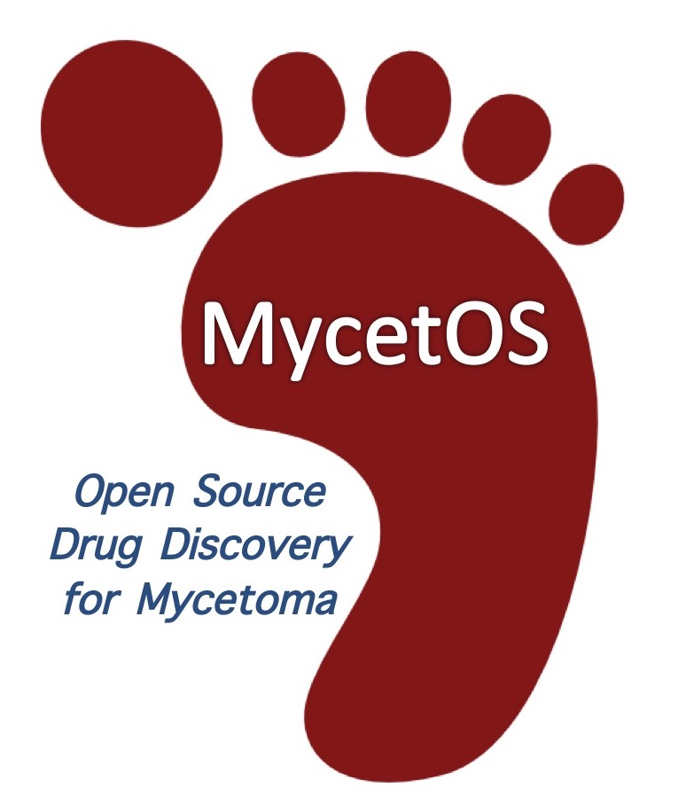
GMWGM, 15th Jan 2025
MycetOS: Open Source Drug Discovery for Mycetoma
Prof Matthew H. Todd
Chair of Drug Discovery, University College London
@mattoddchem
First: what is “Open Source Drug Discovery”?
Second: how have we applied this to mycetoma?
Third: Who?

Slide 2
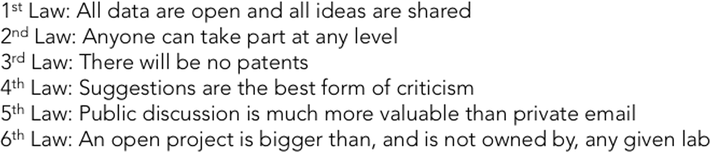
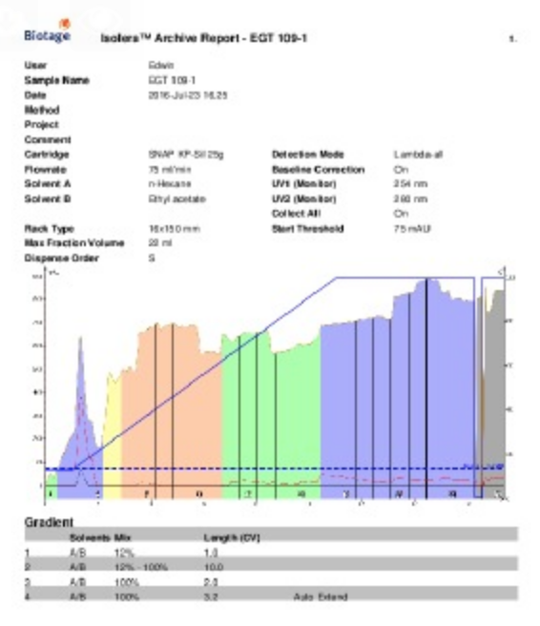
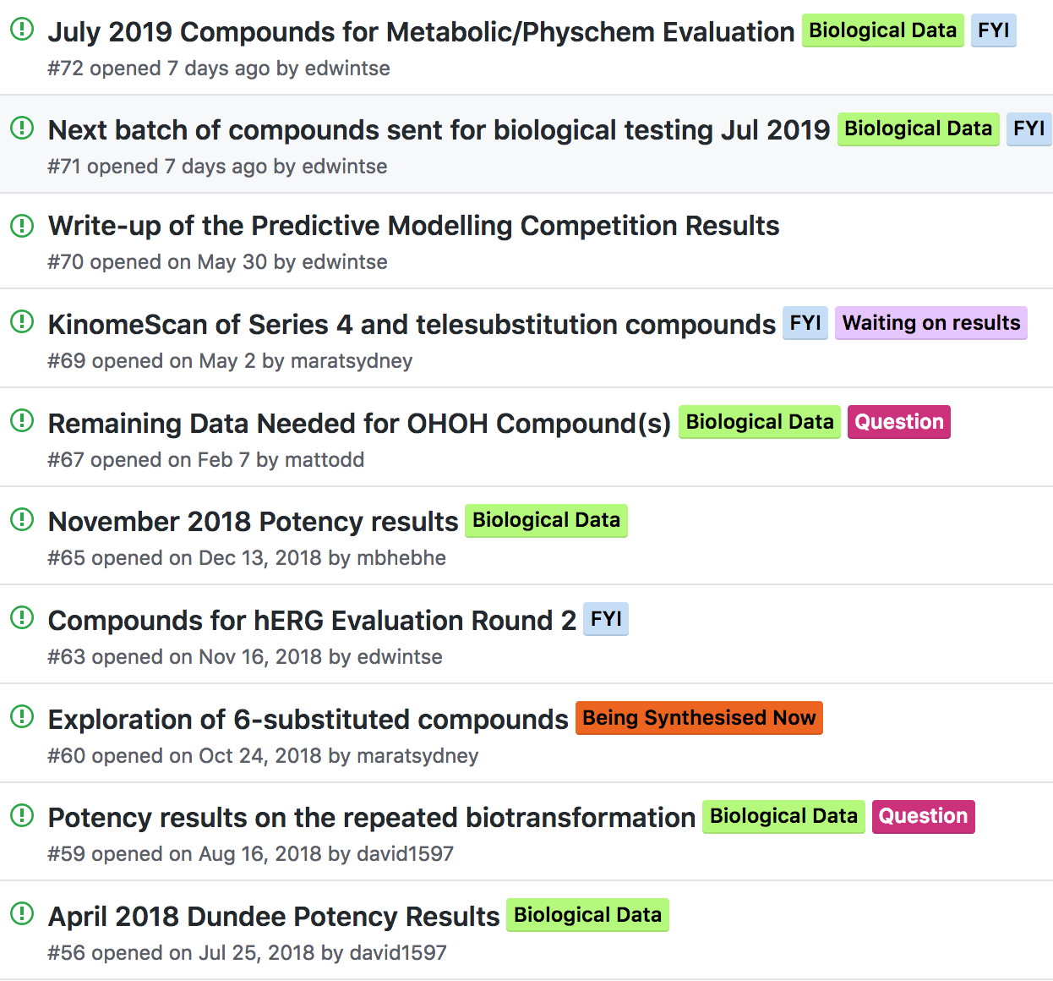
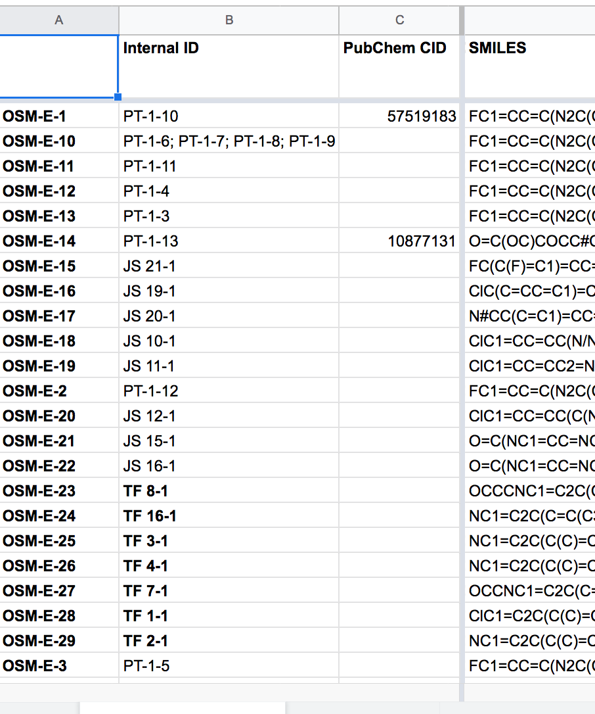
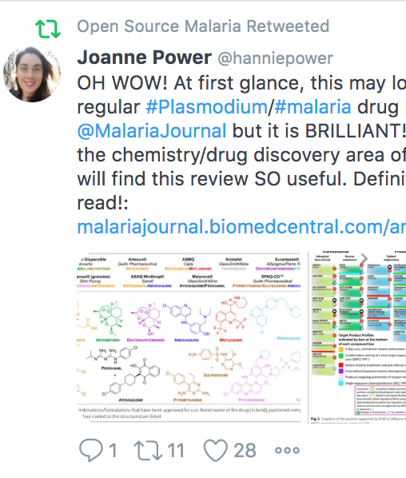
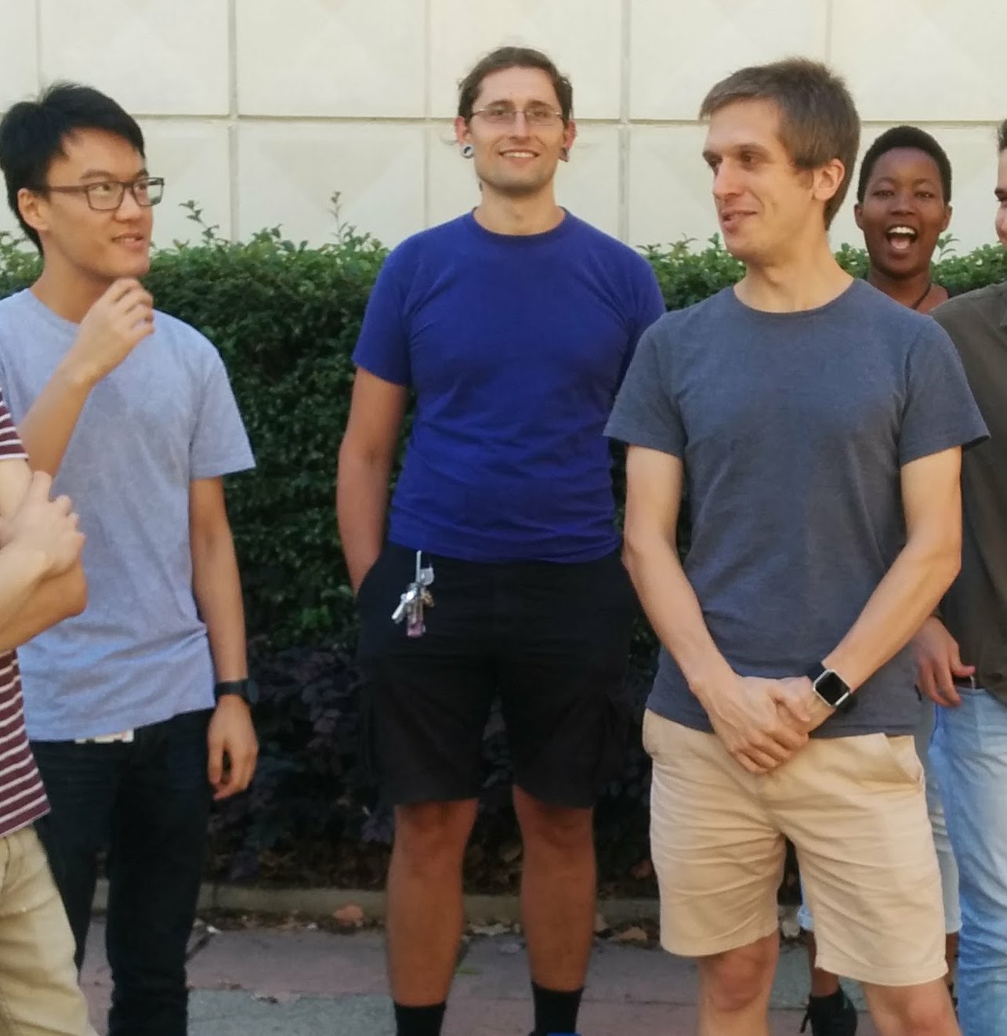
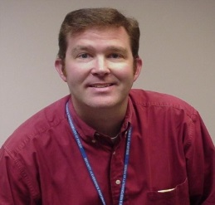
The Open Source Approach
Schisto: Nature Chemistry 2011, 3, 745; PLoS NTD 2011, 5(9): e1260. Malaria: Nature Comms. 2024, 15, 937; ACS Cent. Sci. 2016, 2, 687; J. Med. Chem. 2020, 63, 11585; J. Org. Chem. 2020, 85, 13438; J. Med. Chem. 2021, 64, 16450. TB: J. Med. Chem. 2018, 61, 11327. Antifungals: PLoS NTD 2018, 12(4): e0006437; PLoS NTD 2022, 16, e0010159; Chem. Biodiversity 2023, 20, e202300151. Platform: Chem. Sci. 2015, 6, 1614; Parasitology 2014, 141, 148. Laws: ChemMedChem, 2019, 14, 1804. Translation/Policy: PLoS Med. 2017, 14(4): e1002276; Wellcome Open Res. 2021, 6:146.
Components
Contributions
Laboratory Notebooks
Public To Do Lists/Discussion
Open Data
Community
Students
Pharma

Slide 3
Important to be Clear on Licence and Rules
Everything governed by CC-BY-4.0 licence.
You may do anything with the project contents,
including making money,
provided you cite the project.
Participants have high level of clearly defined freedoms
which you do not control. They do not need to keep asking permission to do things (like use your data).
If you participate, you have agreed to these terms.
Then the fun starts…

Slide 4
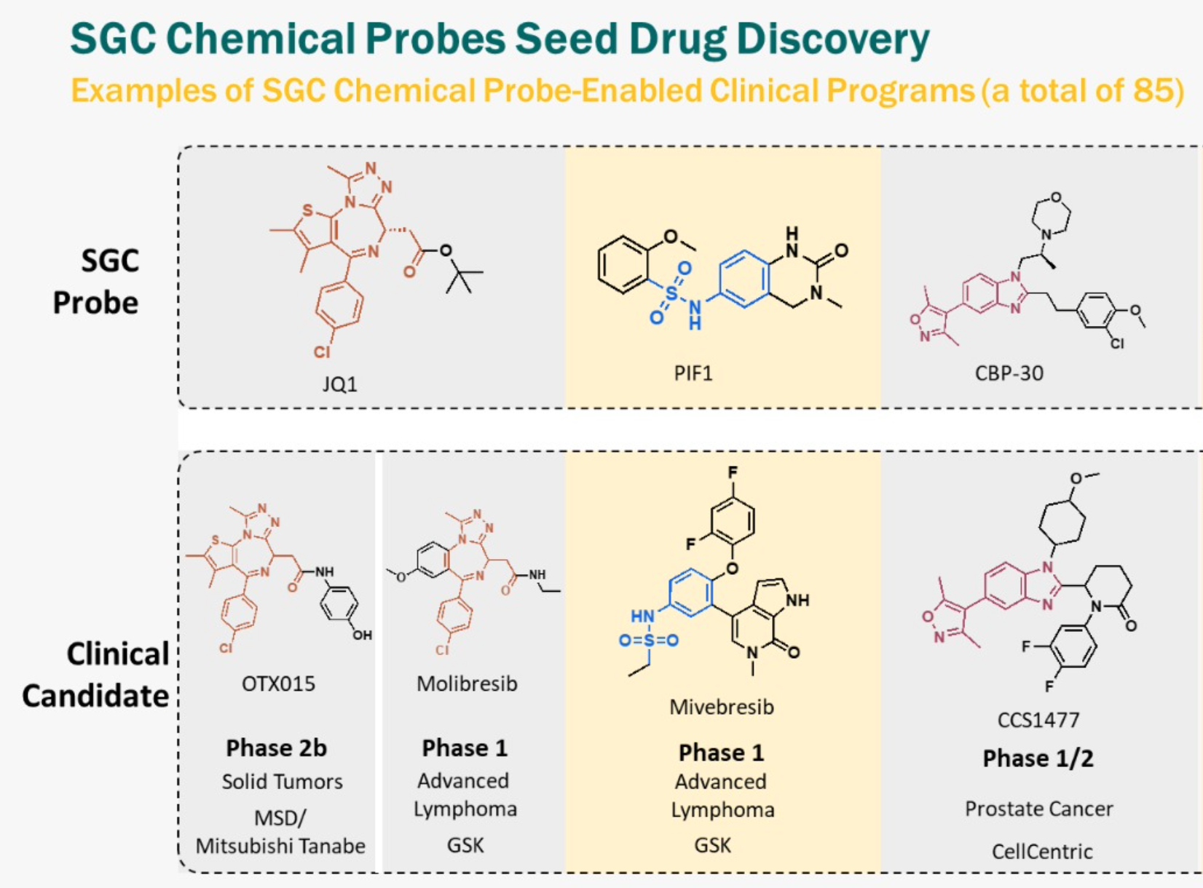

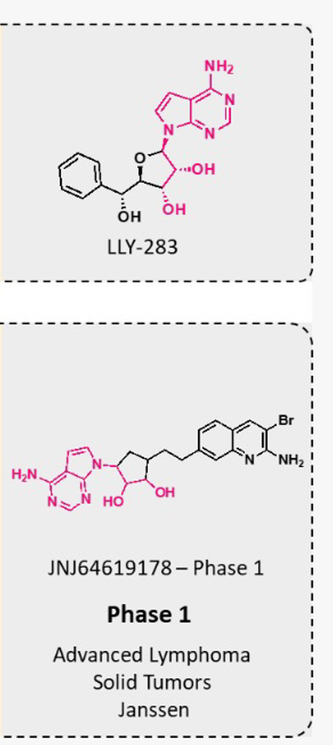
Making molecules open spurs (not inhibits) drug discovery
PFI-1
Notes:
Updated Feb 2023

Slide 5
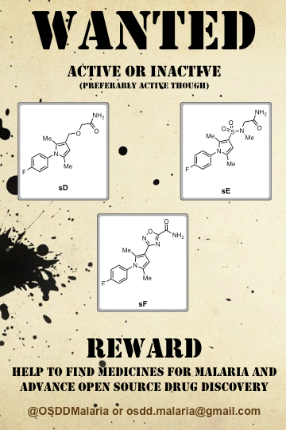
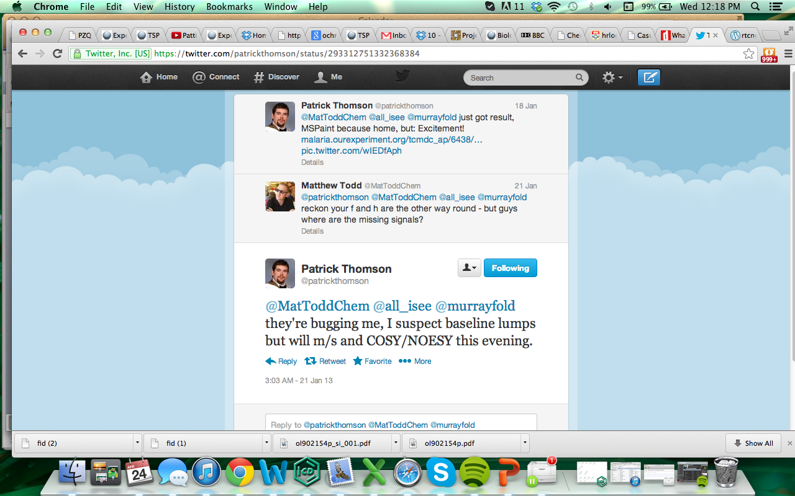
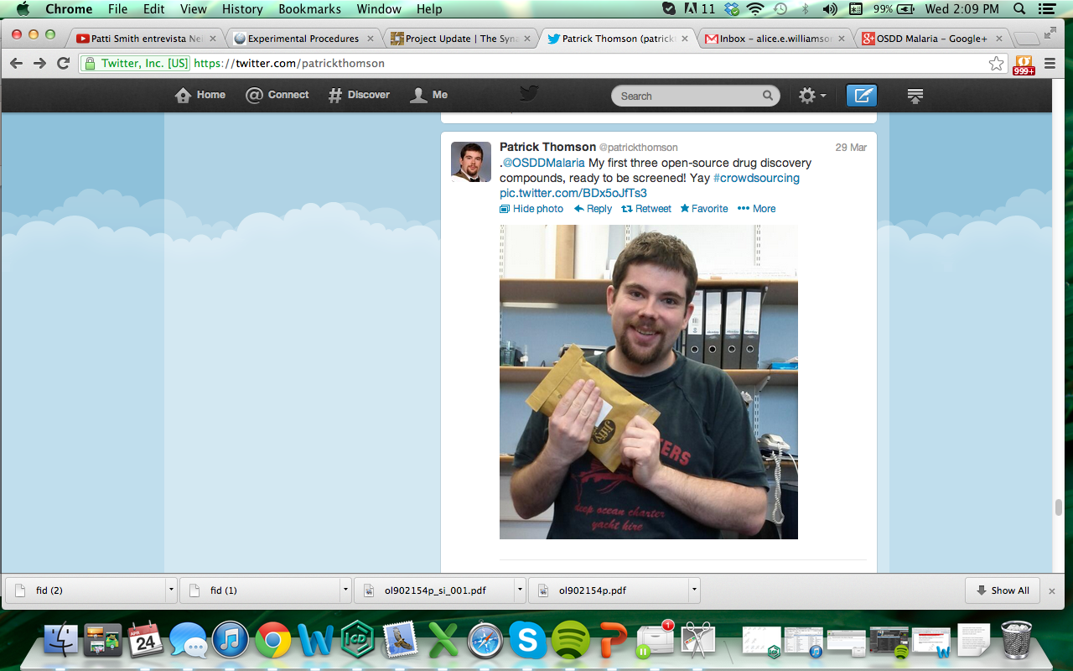
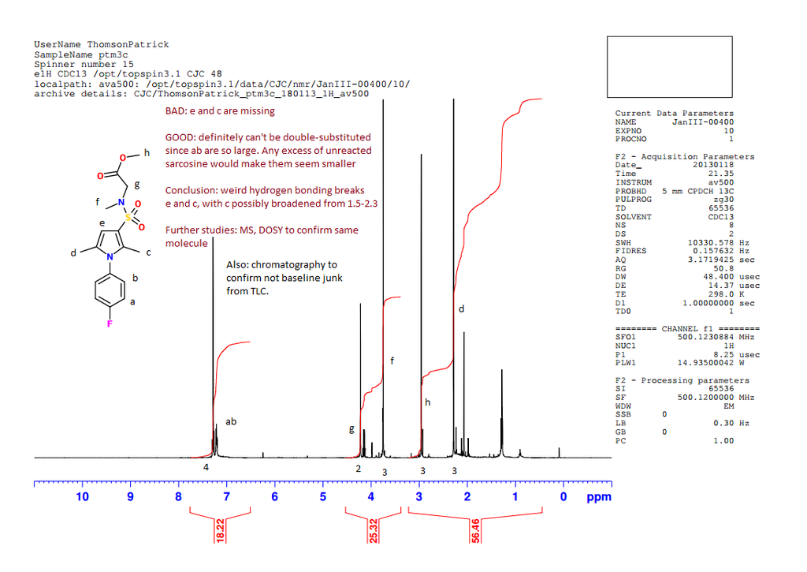
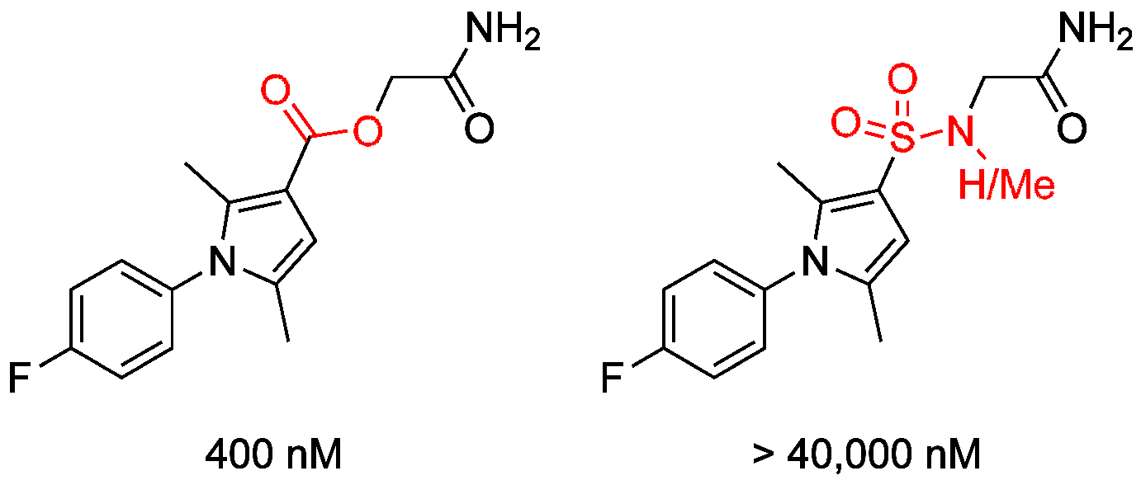
An Example Where it Worked

Slide 6
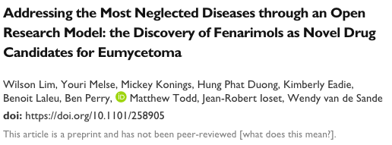
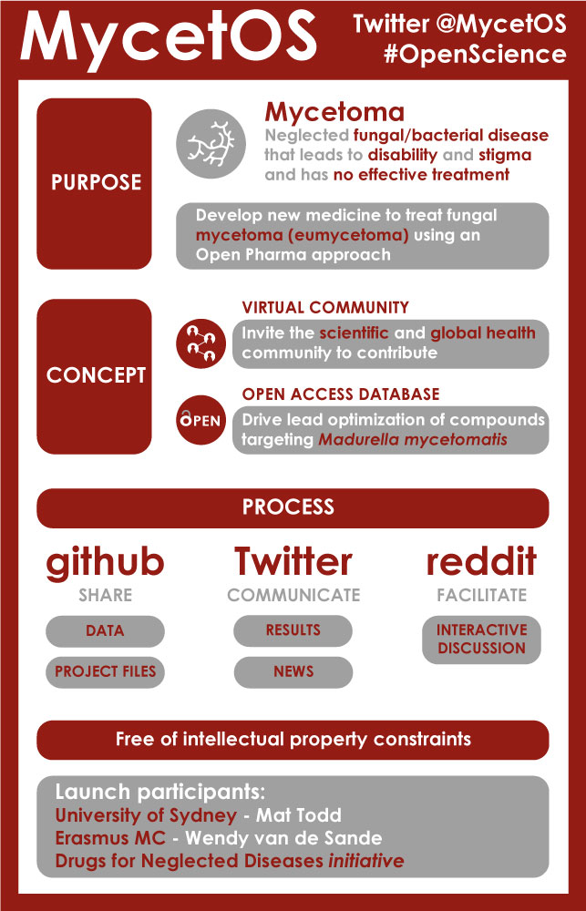
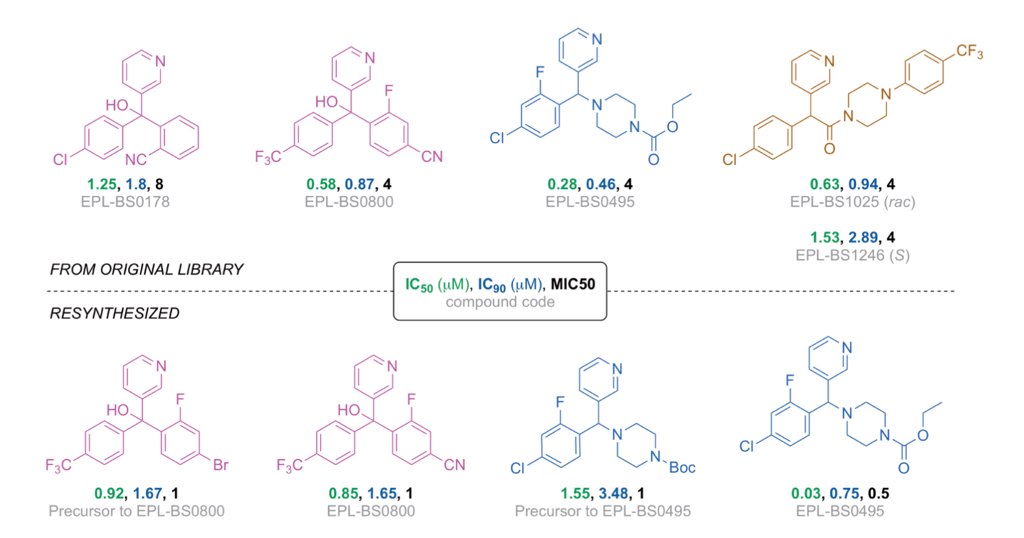
Started as Partnership with DNDi
PLoS NTD 2018, 12(4): e0006437

Slide 7
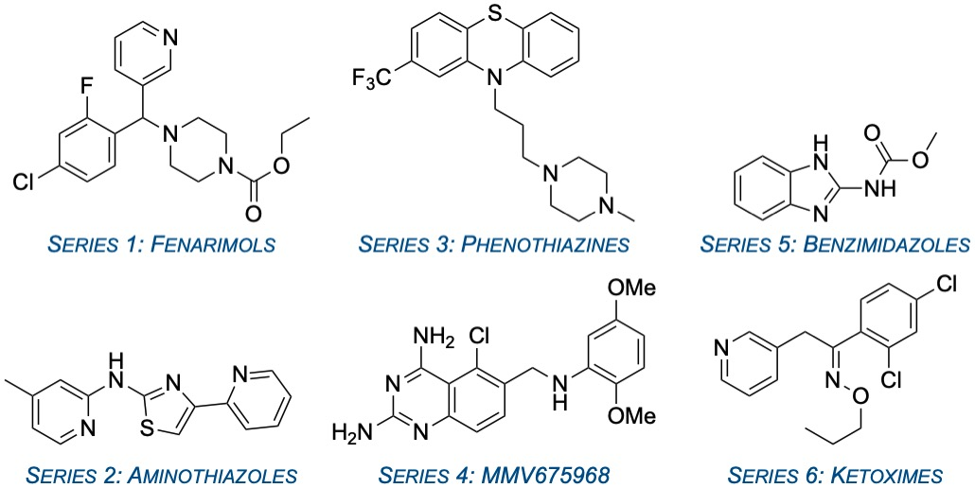
Current Series
https://github.com/OpenSourceMycetoma

Slide 8
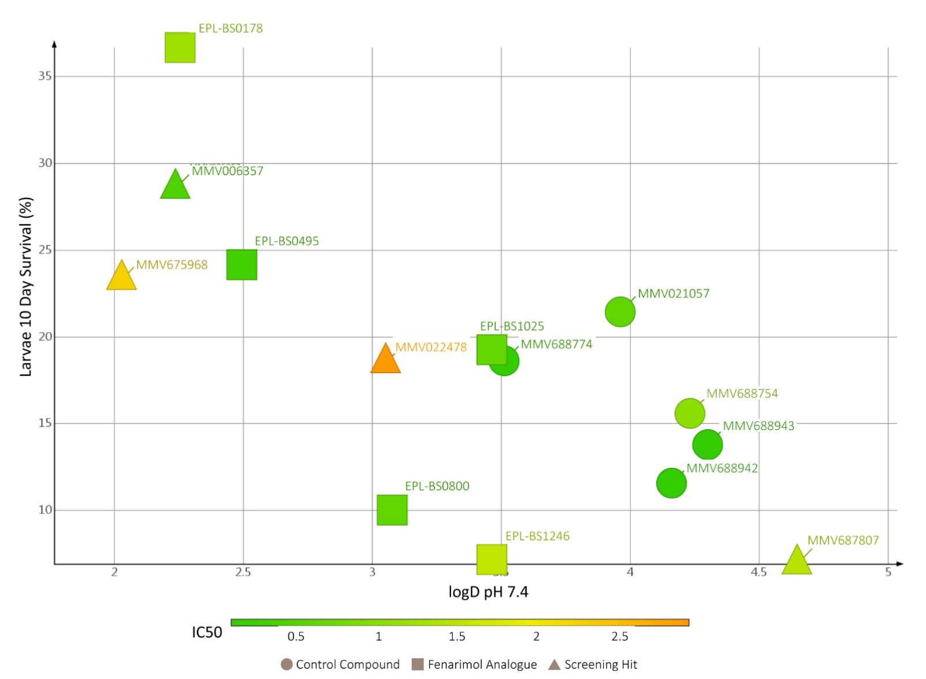
A Research Aim: Solving Grain Penetration
Molecules optimized for in vitro activity are not optimized for in vivo (grain penetration).
W. Lim, et al.
PLoS NTD 2018, 12(4): e0006437.

Slide 9
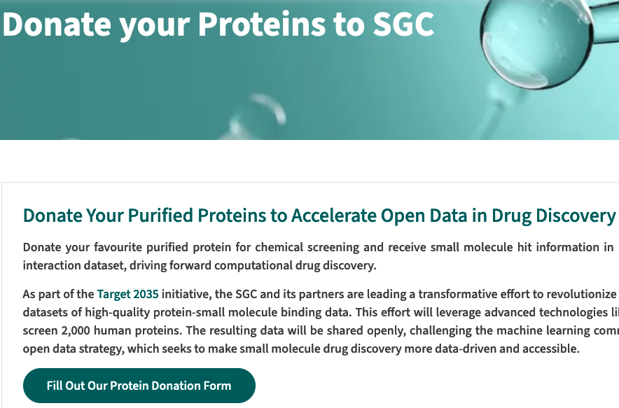
A Research Aim: Identifying New Protein Targets
Lots of antifungal drug discovery projects go after the same targets
We need new targets, and new chemical hits vs those targets.
The Structural Genomics Consortium has a protein donations program.
If you submit about 2 mg of high quality, purified protein, it will be screened in two assays. Hits are made publicly available.
https://www.thesgc.org/donate_proteins_to_SGC

Slide 10
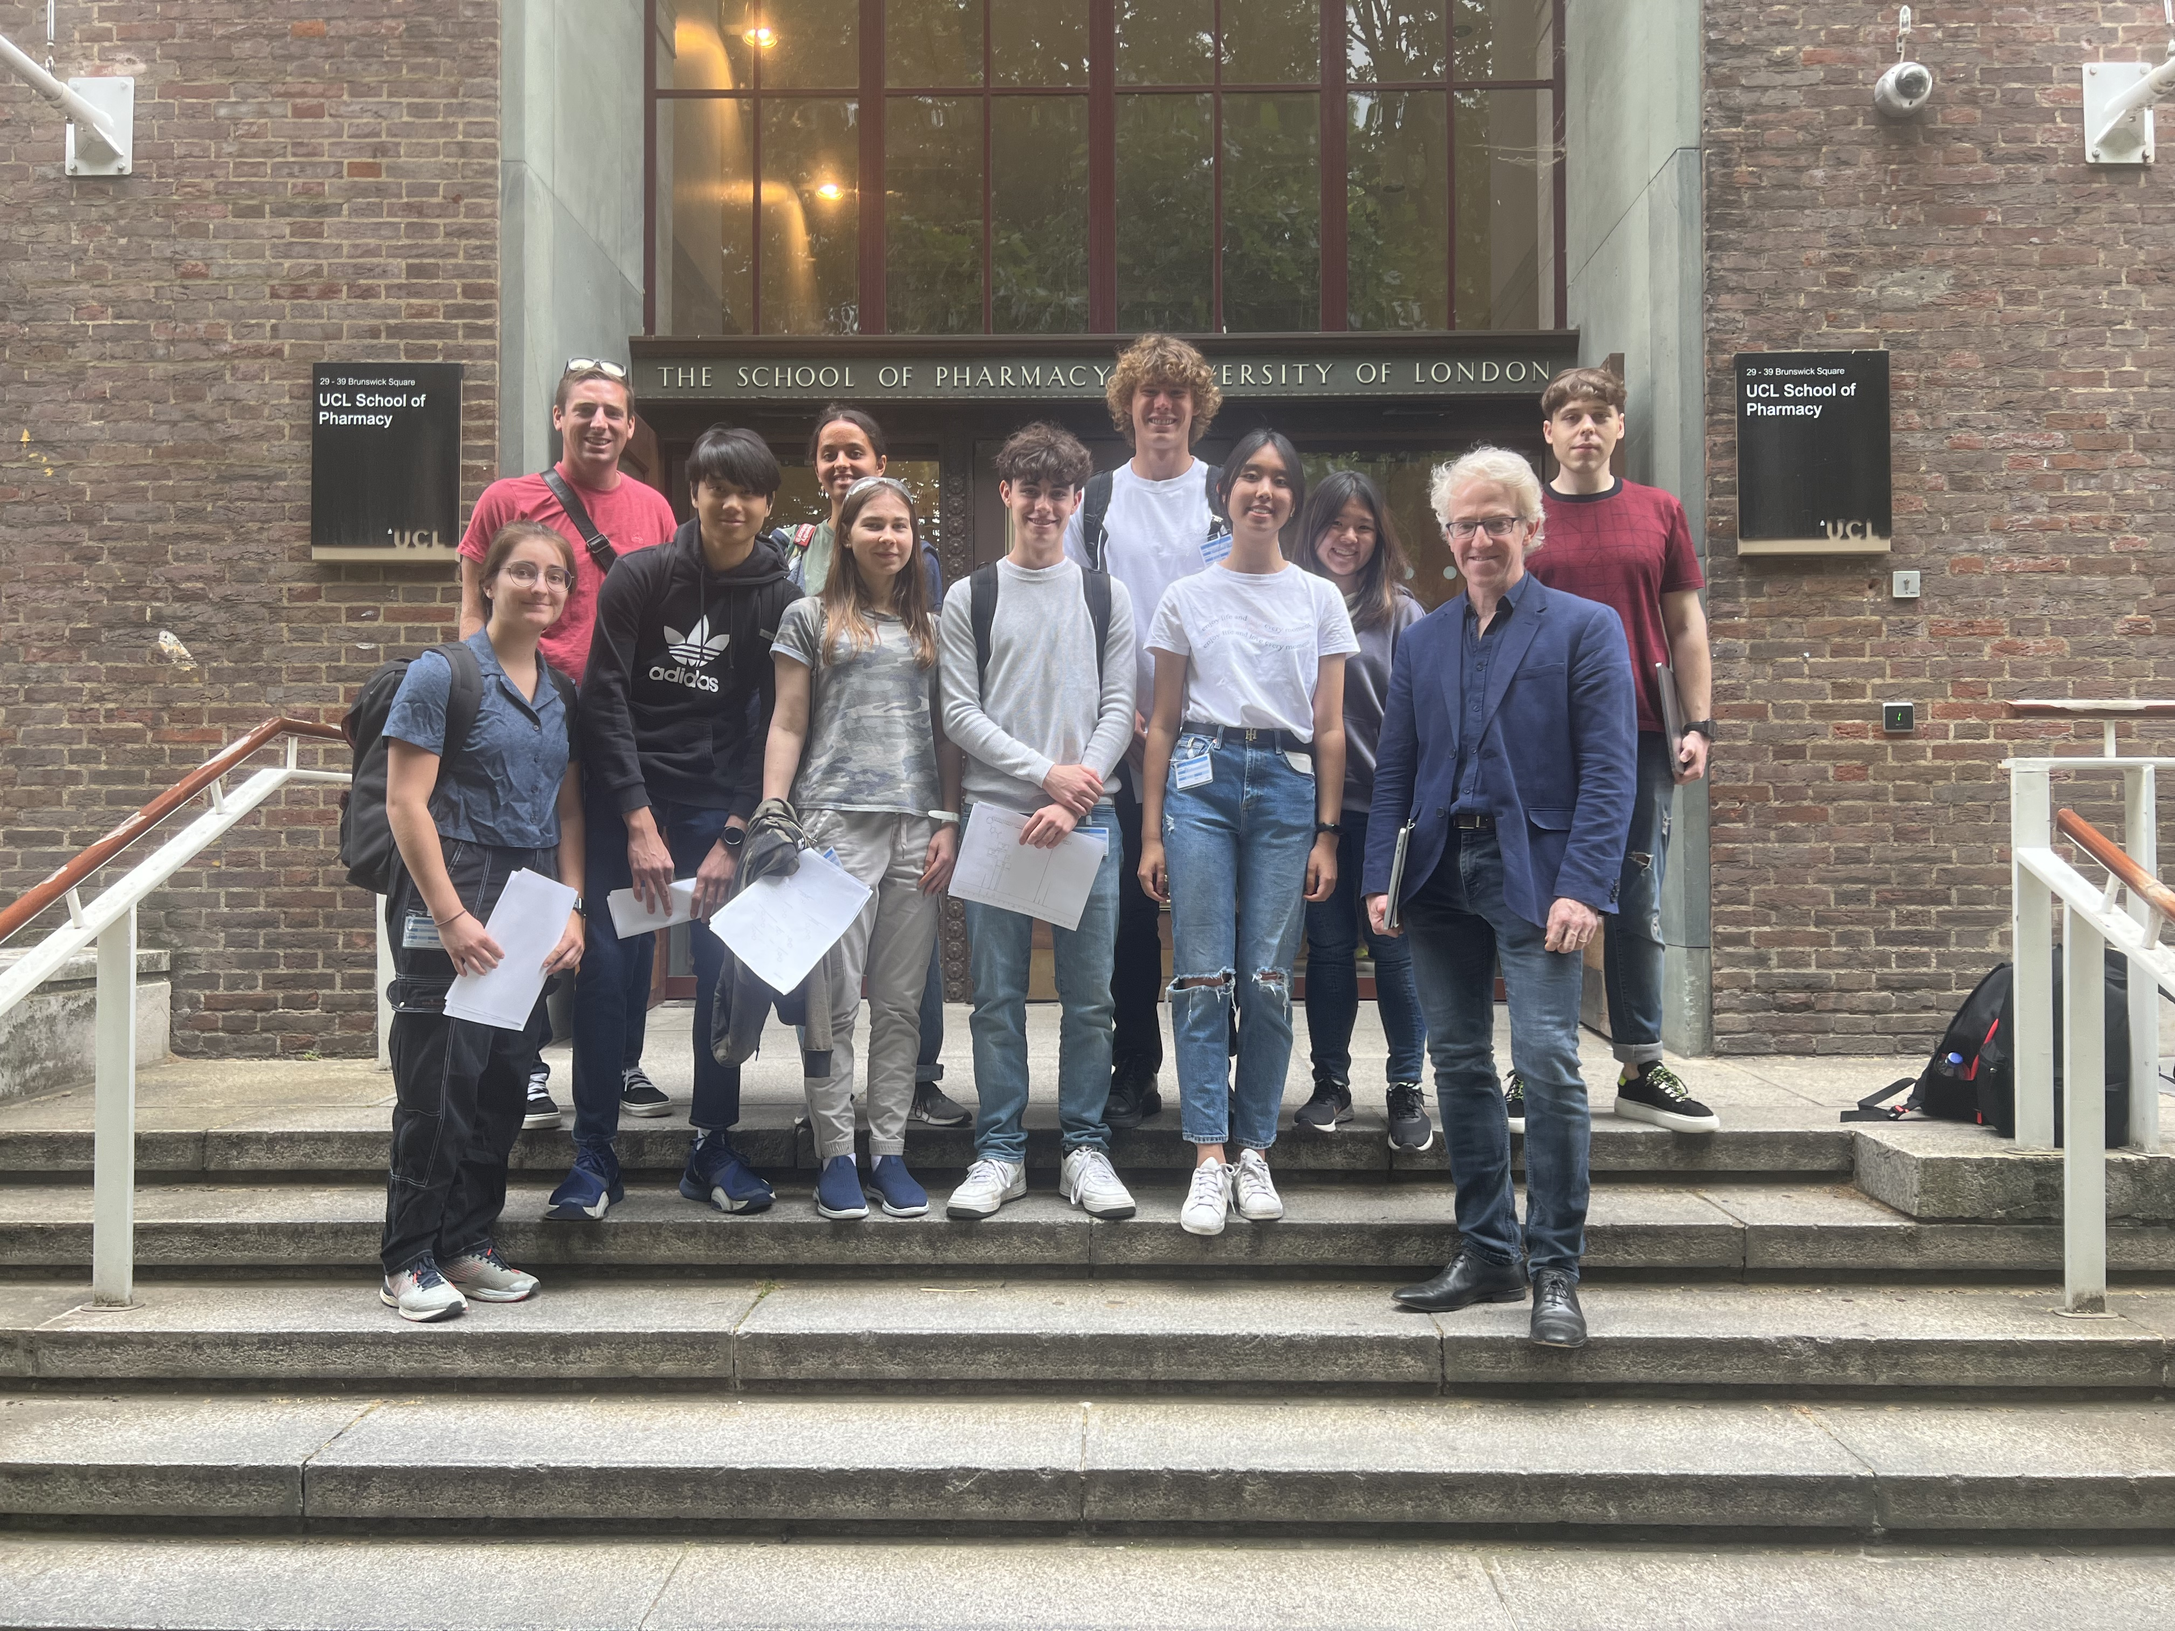
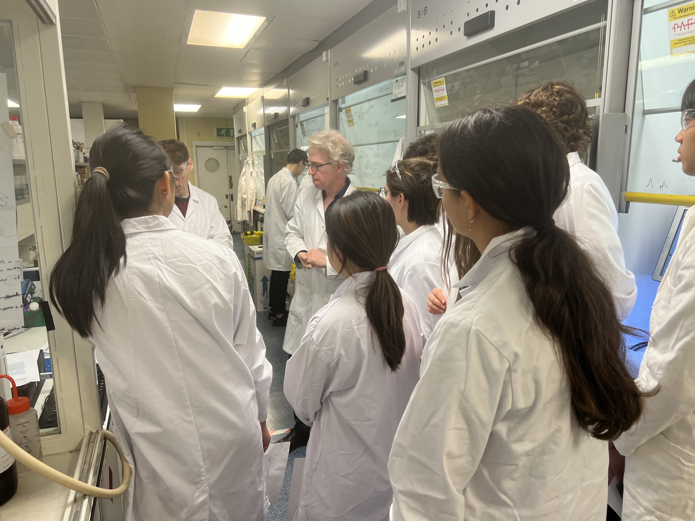
Crowdsourcing: School Projects and Visits
Could you host some crowdsourced research? We have a template.

Slide 11
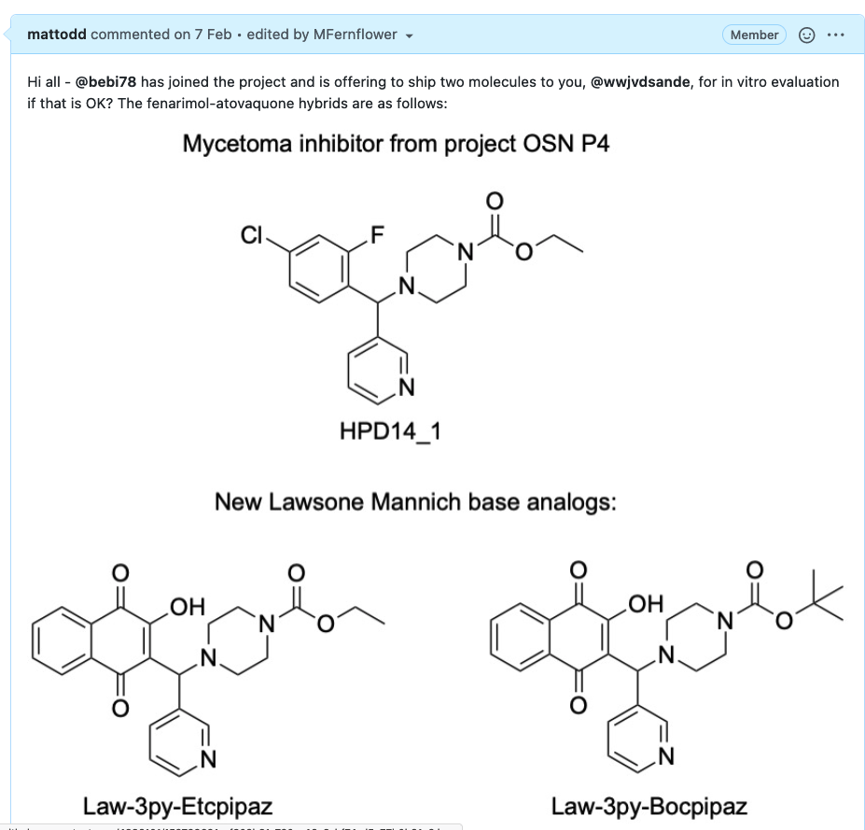
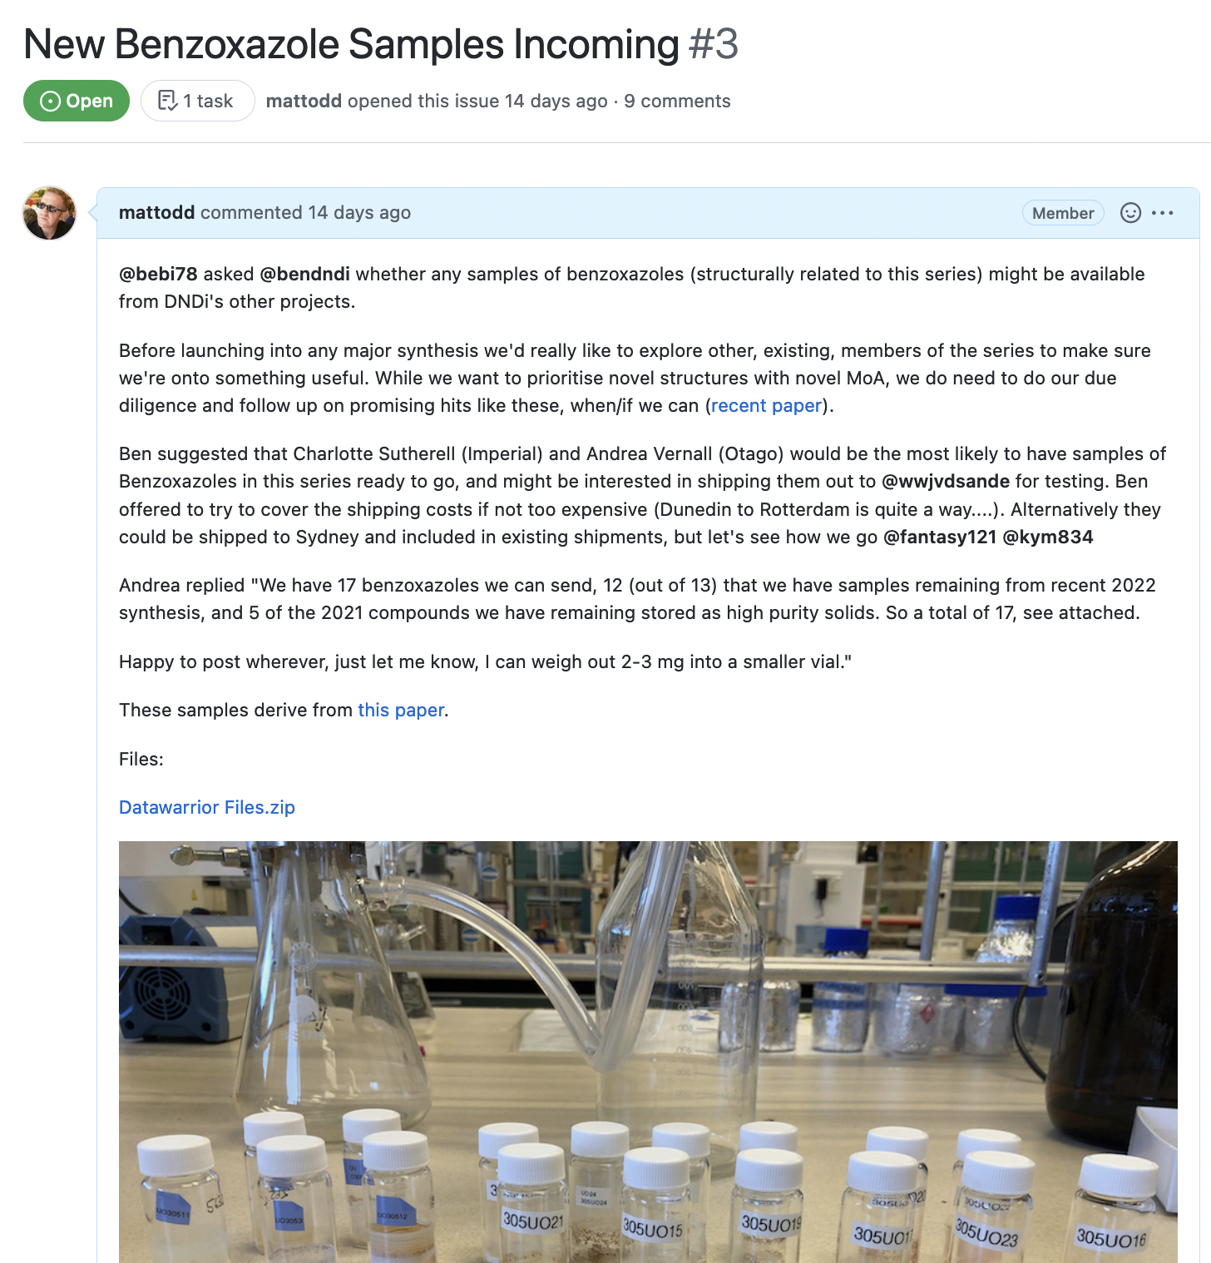
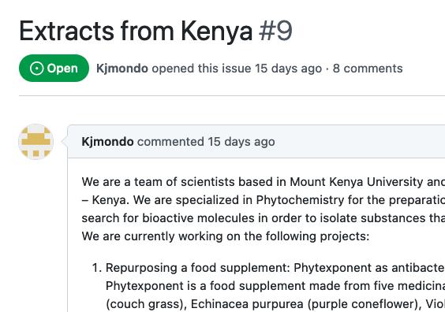
Some Recent Contributions
https://github.com/OpenSourceMycetoma

Slide 12
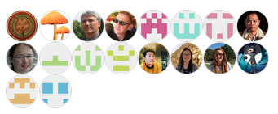
How Can You Get Involved?
Start your own Project!
Contribute molecules, or a protein!
Come to monthly meetings! (next one Jan 28th)
Synthesis planning
https://github.com/OpenSourceMycetoma/Series-2-Aminothiazoles/issues/7
Examination/explanation of the SAR
https://github.com/OpenSourceMycetoma/Series-1-Fenarimols/issues/51
Help with paper writing
https://github.com/OpenSourceMycetoma/Series-1-Fenarimols/issues/55
Students: Become a non-lab based project manager
(contact me if you’re interested)

Slide 13
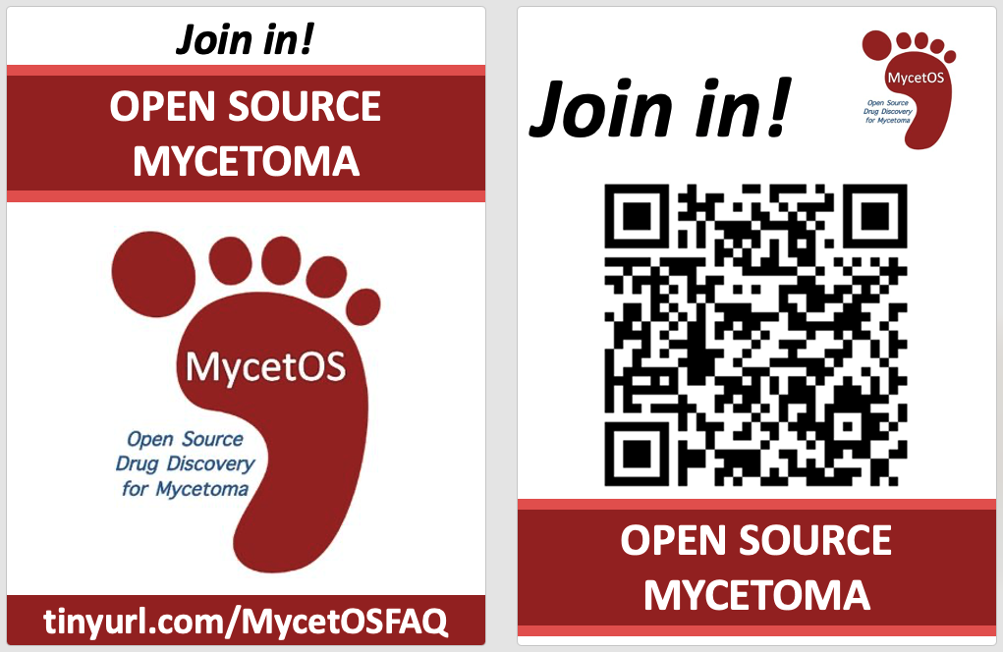
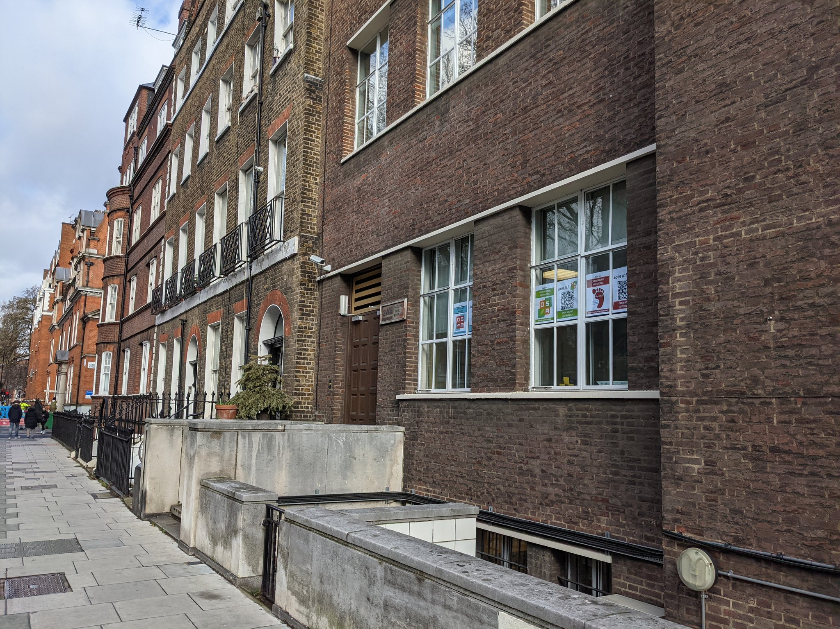
Advertising

Slide 14
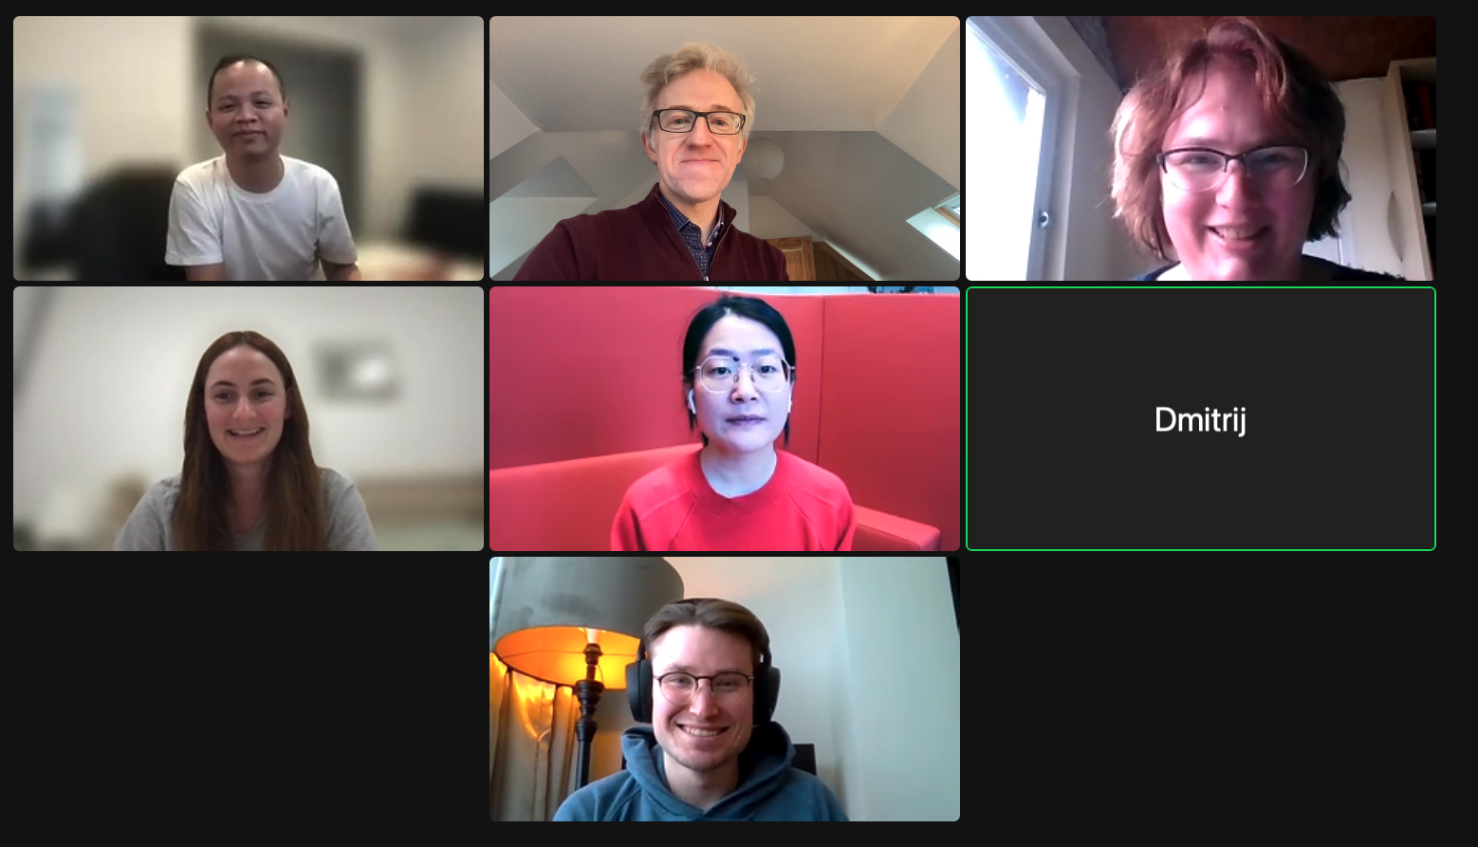
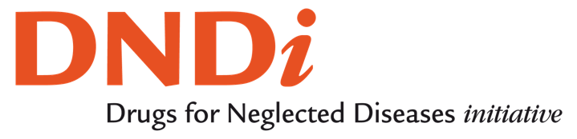



Thanks!
Wendy van de Sande, Ma Jingyi, Wilson Lim, Marij Schippers and team at Erasmus MC, Rotterdam. Hung Phat Duong, Kymberley Scroggie, Klementine Burrell-Sander, Alice Williamson and team at Sydney Uni. Dmitrij Melechov and Erika Loizidou at UCL. Ben Perry and Luiza Cruz at DNDi. Bernhard Biersack (Bayreuth). Charlotte Sutherall (Imperial) Antony Sama in New York City. The Teachers and Students at Whitgift School, Kent. Andrea Vernall (Otago), Julia Sarju and Peter Rayner (York) …and more!

